Slide 1

Natalia (the boss)
Sergio
Nekky
NSN Innovation Corp +49 179 502-555-0152
info@NSN.com
www.NSN.com

Slide 2
Agenda
Introduction
Data quality analysis
EDA (4 questions)
Business Insights for future

Slide 3
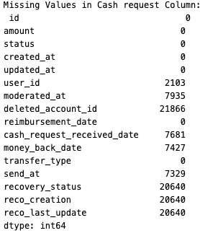
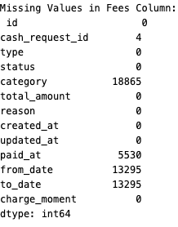
Data Quality analysis Check for duplicates = 0 Check for missing value

Slide 4
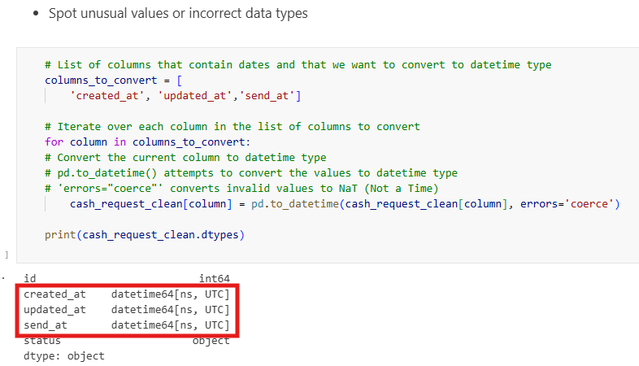
Change the time format to datetime format(before the cohort creation)

Slide 5
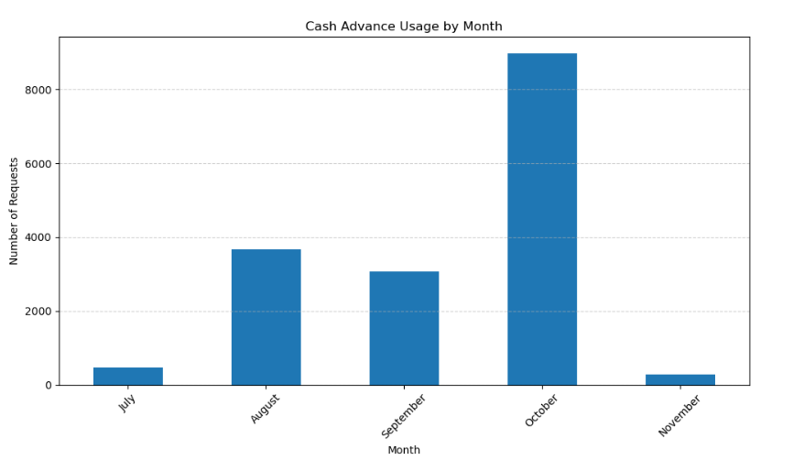
Frequency of Service Usage. Understand how often users from each cohort utilize IronHack Payments' cash advance services over time.

Slide 6
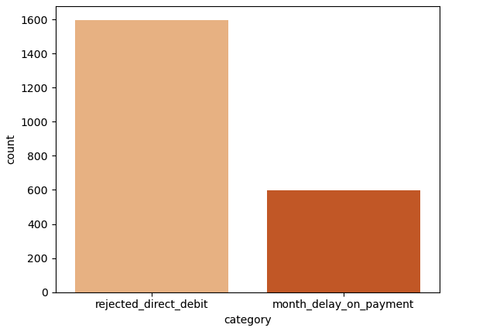
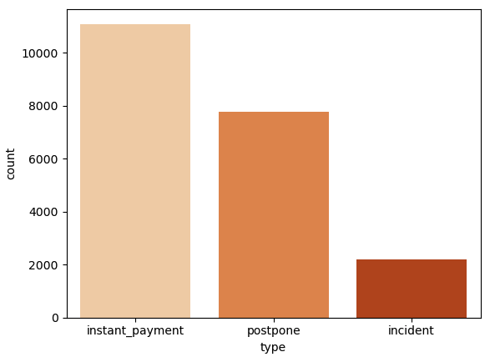

Slide 7
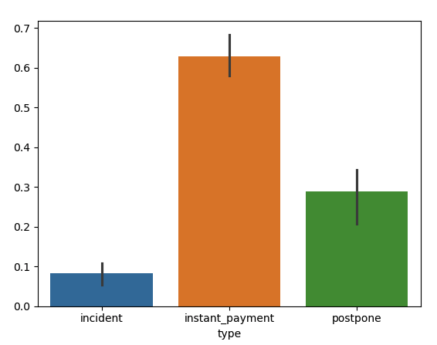
Incident Rate. Determine the incident rate, explicitly focusing on payment incidents, for each cohort. Identify if there are variations in incident rates among different cohorts.
instant_payment : fees for instant cash request (send directly after user's request, through SEPA Instant Payment)
incident : fees for failed reimbursement. Created after a failed direct debit
postpone : fees created when a user want to postpone the reimbursment of a CR

Slide 8
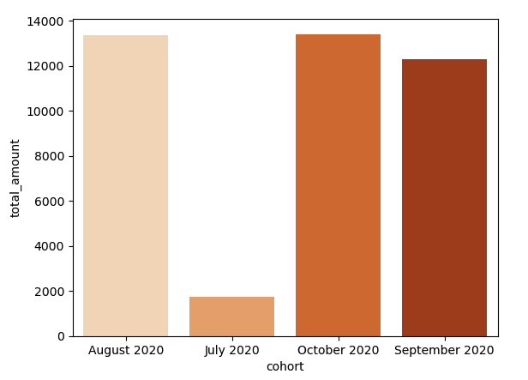
Revenue Generated by the Cohort. Calculate the total revenue generated by each cohort over months to assess the financial impact of user behavior.

Slide 9
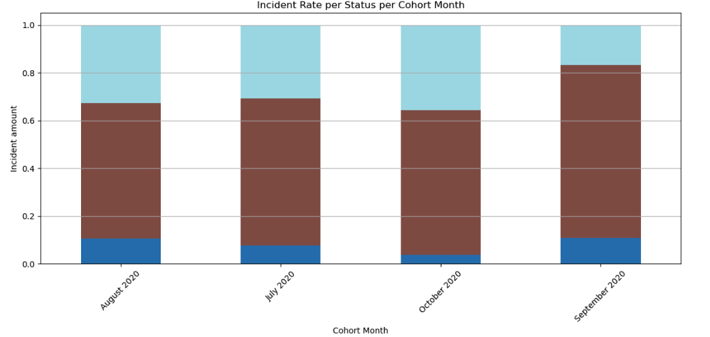
The ratio of Revenue distribution the Cohort
instant_payment : fees for instant cash request (send directly after user's request, through SEPA Instant Payment)
incident : fees for failed reimbursement. Created after a failed direct debit
postpone : fees created when a user want to postpone the reimbursment of a CR

Slide 10
Business Insights for future
cohort utilize IronHack changes according to months
October is the highest
Next studies & research:
Could be related to seasonal or holiday factors for expenses
More promotions and discounts > increases the business revenues

Slide 11
Thank you
NSN Innovation Corp
+49 179 502-555-0152
info@NSN.com
www.NSN.com

